Slide 1


Focus Web Developer
Week 1 - Lesson 3
Notes:
Welcome your class, think about what is the hook to engage your students right out of the starting gate.

Slide 2
Lesson Topics
Developing Environments
HTML with embedded JavaScript
HTML with external JavaScript
Creating HTML docs
Notes:
Pretest and two-way learning

Slide 3

Developing Environment
Today, will use a text editor to create an:
HTML Page with embedded JavaScript
HTML Page with an external JavaScript file
These are going to be our Developing Environments for JS today.

Slide 4



Text Editors
Benefits:
allows us to create code
does not add unwanted symbols
used to create HTML files
used to create CSS files
used to create JavaScript files
Example Text Editors:
NotePad
NotePad ++
Atom
Vim
Brackets

Slide 5

Text Editors
We will be using Atom
Free to use
Allows creation of HTML, CSS, JS
Code colouring
Works well with projects
Automatic Tag Closing - download here: https://atom.io/packages/autoclose-html
Notes:
Images
Atom - https://duckduckgo.com/?q=atom+text+editor+logo&t=brave&iar=images&iax=images&ia=images&iai=https%3A%2F%2Fdl2.macupdate.com%2Fimages%2Ficons256%2F53196.png%3Fd%3D1518722998

Slide 6
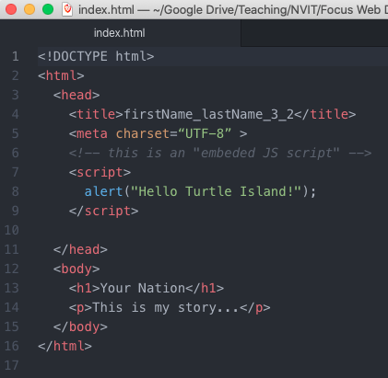
Embedded JavaScript
HTML Page with embedded JavaScript:
The JS is written in the same document as your HTML – this means there will be two languages in one document
JS code must appear between <script></script> tags
JS code lines end with a semicolon ;

Slide 7
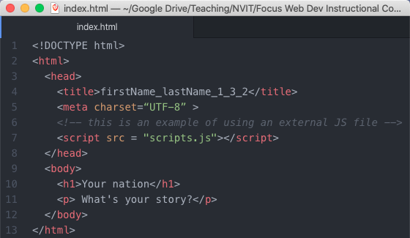
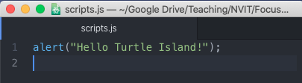
External JavaScript
HTML Page with an external JavaScript file:
The JS is written in a different document as your HTML – this means your HTML file must reference your external JS file*
*JavaScript files have a file extension of .js

Slide 8

Development Environment
HTML Pages with embedded JS (or external JS) are good Developing Environments because they:
are easy to set up
get us practicing writing HTML, CSS, JS
Does not need any other tools such as environment tools
Notes:
Image from
https://duckduckgo.com/?q=facebook+like+image&t=brave&iar=images&iax=images&ia=images&iai=https%3A%2F%2Fupload.wikimedia.org%2Fwikipedia%2Fcommons%2Fthumb%2F5%2F50%2FFacebook_Thumb_icon.svg%2F1200px-Facebook_Thumb_icon.svg.png

Slide 9

Activity 1
Create a new html document in Atom
Name the file firstName_lastName_1_3_1.html
Follow along with the creation of the file
Write HTML structure
Embed JS
Create an HTML file with embedded JS
Notes:
Review the importance of file naming conventions with the students. Also review WHERE they should save this file.

Slide 10
HTML with Embedded JS
<!DOCTYPE html>
<html>
<html/>

Slide 11
HTML with Embedded JS
<!DOCTYPE html>
<html>
<head></head>
<body></body>
</html>

Slide 12
HTML with Embedded JS
<!DOCTYPE html>
<html>
<head>
</head>
<body>
</body>
</html>

Slide 13
HTML with Embedded JS
<!DOCTYPE html>
<html>
<head>
<title></title>
</head>
<body>
</body>
</html>

Slide 14
HTML with Embedded JS
<!DOCTYPE html>
<html>
<head>
<title>My First JavaScript Page</title>
</head>
<body>
</body>
</html>

Slide 15
HTML with Embedded JS
<!DOCTYPE html>
<html>
<head>
<title>My First JavaScript Page</title>
<meta charset=“UTF-8” >
</head>
<body>
</body>
</html>

Slide 16
HTML with Embedded JS
<!DOCTYPE html>
<html>
<head>
<title>My First JavaScript Page</title>
<meta charset=“UTF-8” >
</head>
<body>
<h1>A JavaScript Embedded Web Page</h1>
</body>
</html>

Slide 17
HTML with Embedded JS
<!DOCTYPE html>
<html>
<head>
<title>My First JavaScript Page</title>
<meta charset=“UTF-8” >
</head>
<body>
<h1>A JavaScript Embedded Web Page</h1>
<p>Hello World, this is my first JavaScript Embedded Web Page!</p>
</body>
</html>
Note: at this point no JavaScript has been embedded… yet!

Slide 18

HTML with Embedded JS
Test your Web Page!
If something doesn’t look like it should:
Check for typos
Check for missing closing tags

Slide 19
Development Environment
<!DOCTYPE html>
<html>
<head>
<title>My First JavaScript Page</title>
<meta charset=“UTF-8” >
<script>
</script>
</head>
…
add <script> tags within your <head> tags

Slide 20
Development Environment
<!DOCTYPE html>
<html>
<head>
<title>My First JavaScript Page</title>
<meta charset=“UTF-8” >
<script>
alert(“Hello Turtle Island!”);
</script>
</head>
…
Add your first line of embedded JavaScript code!

Slide 21
HTML with Embedded JS
Test your Web Page!
If something doesn’t look like it should:
Check for typos
Check for missing closing tags

Slide 22
JavaScript Functions
alert(“Hello Turtle Island!”);
We are calling a pre-written JavaScript function to create a pop up that says “Hello Turtle Island”
alert(); is the function
“Hello Turtle Island” is the argument that is passed to the function
in JS it is possible to create your own functions!

Slide 23
JavaScript Functions
The general format for a JS function is:
functionName (parameter1, parameter2, parameter3…);
Pre-written functions have pre-specified types and numbers of parameters that may be passed to it
parameters – the variable required by the function
argument – the specific value of the parameter being used
calling a function – using a function
passing information – inputting values for the function to use

Slide 24
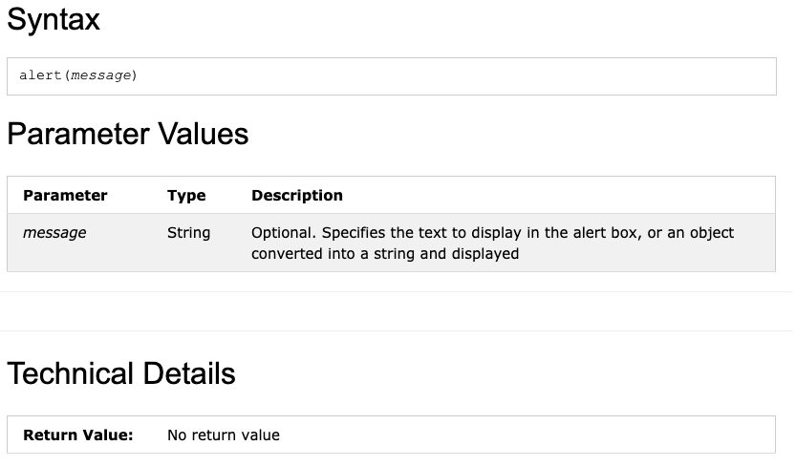
JavaScript Functions
The alert(); function specifics (look up on W3 Schools)
Generic syntax of the alert() function
alert() only accepts strings as arguments
The function doesn’t provide anything back to the computer

Slide 25
JavaScript Functions
alert(“Hello Turtle Island!”);
We are calling the alert() function and passing the string “Hello Turtle Island” to to function as our argument

Slide 26
Activity 2
Create a new HTML file with embedded JS
Name the file firstName_lastName_1_3_2.html
Set the title as firstName_lastName_1_3_2
Put the name of your nation in the h1 tag
Write a paragraph about your nation
Create a pop-up that displays the name of your nation
Create a new web page with embedded JavaScript

Slide 27

HTML with external JS
Now, we will practice JavaScript by creating an HTML file and a separate JS file.

Slide 28
HTML with external JS
Benefits of using external JS files:
Easier to stay organized - JS code can be long and it will be harder to read if it is embedded in HTML
Easier to find and fix issues with JS code
Multiple JS files can be used in one HTML file
Other peoples’ JS files can be used – these are called libraries
Best Practice for Web Development

Slide 29

Best practice for Web Development
Separate the different components in to separate layers:
Structure Layer (HTML5)
Presentation Layer (CSS)
Functionality Layer (JavaScript)

Slide 30
Best practice for Web Development
By creating a separate JavaScript file we are helping to keep our layers separate which helps with:
Finding issues
Using other peoples work
Attaching as many JavaScript files as we need

Slide 31
Discussion
In groups, discuss the following about coding:
What did you find difficult?
What did you like?
What would you like to get better at?
Please feel free to use this time to share things that you have learned and think would be useful for others to know!

Slide 32
Activity 3
Recreate your HTML file from Activity 2 today, but name it firstName_lastName_1_3_3.html
Check to make sure that it works with the pop-up
Create external JS file named ”scripts.js”
Remove the JS code from HTML and put it in “scripts.js”
Attach external JS file in HTML
Test your code!
You may use these vague instructions or check out the next slides for a detailed solution
HTML with external JS

Slide 33
Activity 3 Solution (Steps 1-3)
Step 1: Copy and paste your HTML file from Activity 2 and rename it
Step 2: Check that your new HTML file works
Step 3: In Atom, create a new file named “scripts.js” – make sure this file is located in the same folder as your new HTML file

Slide 34
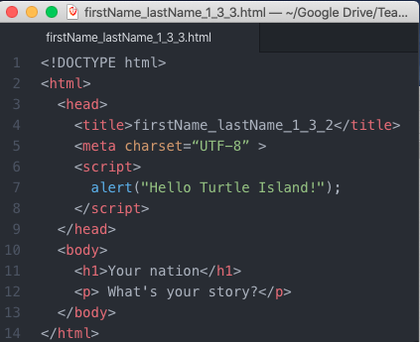
Activity 3 Solution (Step 4)
This line is the JS code, cut (Ctrl+x) and paste (Ctrl+v) it into your scripts.js file
Step 4 continued on next slide…

Slide 35
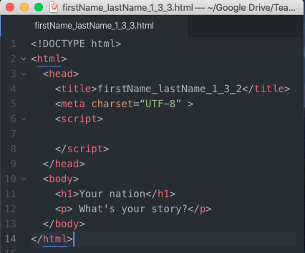
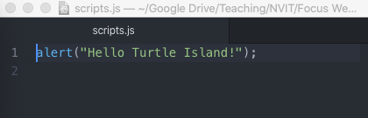
Activity 3 Solution (Step 4)
This is what your HTML and JS files should look like after Step 4

Slide 36
Activity 3 Solution (Step 5)
“attach” your JS file by changing the opening tag to:
<script src = “scripts.js”>
Note: in this case, it is “best practice” to put the closing script tag on the same line as the opening script tag
Step 5 continued on next slide…

Slide 37
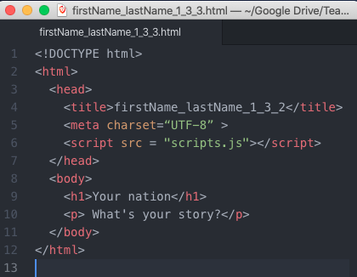
Activity 3 Solution (Step 5)
This is what your HTML and JS files should look like after Step 5

Slide 38
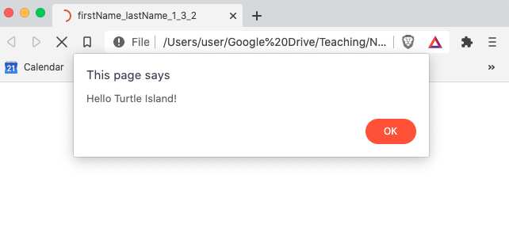
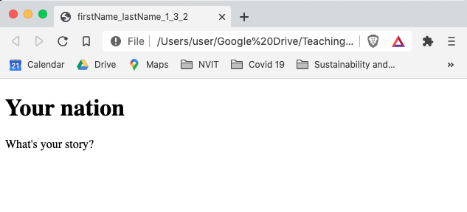
Activity 3 Solution (Step 6)
Test your code by opening your HTML file with your favourite web browser. Hopefully, it looks something like this!
Before clicking “OK”
After clicking “OK”

Slide 39
Attaching an external JS file
The general format used to attach a JS file to an HTML file is:
<script src = “filename” ></script>
src means “source”
= means “set to”
” ” around filename mean that filename is a string
filename is the name of the file being used

Slide 40
Attaching an external JS file
A few more notes notes about <script src = “filename” ></script>
Although there is nothing between <script></script> both tags are still needed because <script> is not a self-closing tag
filename may include a relative path if the JS file is not located in the same folder as the HTML file
filename must include the file type extension (.js)

Slide 41
Attaching an external JS file
Compare:
general format <script src = “filename” ></script>
specific format <script src = “scripts.js” ></script>
File extension type

Slide 42
Best Practice for external JS files
Attach external JS to HTML in one line of code by putting <script> tags on the same line
Name the external JS file “scripts.js”
The .js means it is a JavaScript file
Save scripts.js in the same folder as your html file

Slide 43
HTML with Embedded JS
Test your Web Page!
If something doesn’t look like it should:
Check for typos
Check for missing closing tags

Slide 44

Keep up the great work!

Slide 45

Class Wrap-up
How did class go today?
What are you looking forward to adding to your website?
Notes:
Post test: provide students with feedback and a review of the day
End of the day Q/A
Were the day’s goals meet (reference slide 2)?
Transition: what’s coming up tomorrow?

Slide 46
Image Credits
Unless specified, all images in this slide show are from the following sources
Unsplash via the Unsplash License
Pexels and Pixabay via the CC0 License or the Pexels License
Wikimedia Commons
First Nations Technology Council and its partners
Check Marks https://www.freepik.com/free-vector/check-marks-3d_819413.htm
Fruit https://tbivision.com/2012/11/30/australias-abc-acquires-annoying-orange/

